Slide 1
11. Graphs and Trees 1
Graphs: Definitions Trails, Paths, and Circuits Matrix Representations Planar Graphs
Aaron Tan
29 October – 2 November 2018

Slide 2
Graphs: Definitions Trails, Paths, and Circuits Matrix Representations Planar Graphs
The origins of graph theory are humble, even frivolous.
Whereas many branches of mathematics were motivated by fundamental problems of calculation, motion, and measurement, the problems which led to the development of graph theory were often little more than puzzles, designed to test the ingenuity rather than to stimulate the imagination. But despite the apparent triviality of such puzzles, they captured the interest of mathematicians, with the result that graph theory has become a subject rich in theoretical results of a surprising variety and depth.
~ N. Biggs, E. K. Lloyd, and R. J. Wilson

Slide 3
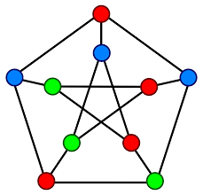
Graphs: Definitions Trails, Paths, and Circuits Matrix Representations Planar Graphs
10.1 Graphs: Definitions and Basic Properties

Slide 4
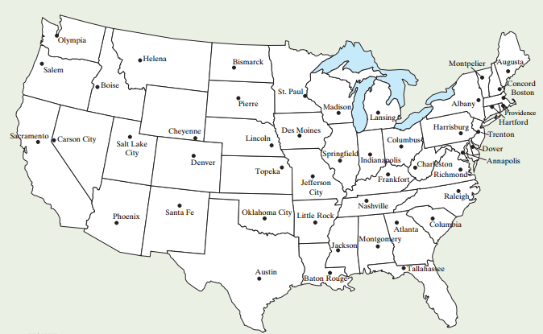
Graphs: Definitions Trails, Paths, and Circuits Matrix Representations Planar Graphs
Graphs: Introduction
Graphs: Introduction
Shall we add some colours to this map of the United States?

Slide 5
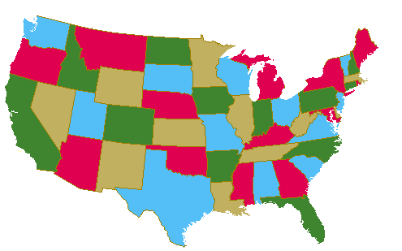
Graphs: Definitions Trails, Paths, and Circuits Matrix Representations Planar Graphs
Graphs: Introduction
Graphs: Introduction
Shall we add some colours to this map of the United States?

Slide 6
Graphs: Definitions Trails, Paths, and Circuits Matrix Representations Planar Graphs
Graphs: Introduction
Map Colouring
Four-Colour Conjecture
Proposed by Guthrie in 1852, who conjectured that…
Four colours are sufficient to colour any map in a plane, such that regions that share a common boundary do not share the same colour.
Many false proofs since then.
Finally proved by Appel and Haken in 1977, with the help of computer.
Robertson et al. provided another proof in 1996.

Slide 7
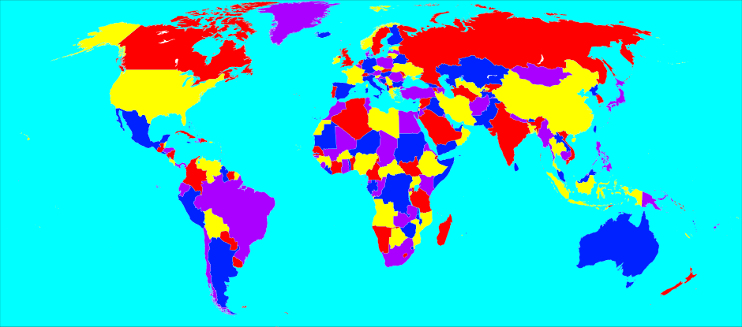

Graphs: Definitions Trails, Paths, and Circuits Matrix Representations Planar Graphs
Graphs: Introduction
Map Colouring
Example of a 4-coloured map.
World map with 4 colours.
But this is a map, not a graph!
However, we can model it as a graph.
But what is a graph?

Slide 8
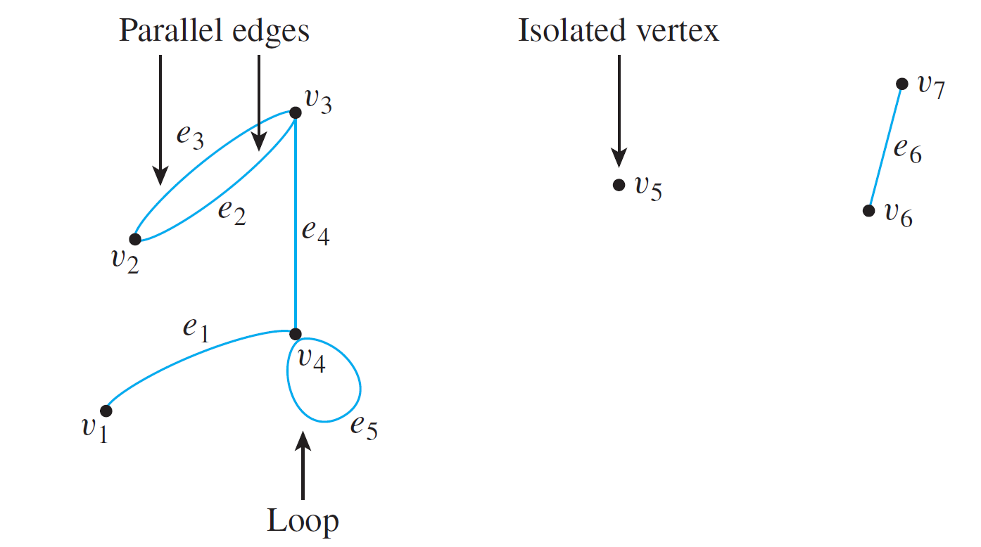
Graphs: Definitions Trails, Paths, and Circuits Matrix Representations Planar Graphs
Graphs: Definitions and Basic Properties
Graphs: Definitions and Basic Properties
A graph G consists of
a set of vertices V(G), and
a set of edges E(G).
Sometimes, we write G = {V, E}.
An edge connects one vertex to another, or a vertex to itself.

Slide 9
Graphs: Definitions Trails, Paths, and Circuits Matrix Representations Planar Graphs
Graphs: Definitions and Basic Properties
Graphs: Definitions and Basic Properties
Definition: Graph
A graph G consists of 2 finite sets: a nonempty set V(G) of vertices and a set E(G) of edges, where each edge is associated with a set consisting of either one or two vertices called its endpoints.
An edge is said to connect its endpoints; two vertices that are connected by an edge are called adjacent vertices; and a vertex that is an endpoint of a loop is said to be adjacent to itself.
An edge is said to be incident on each of its endpoints, and two edges incident on the same endpoint are called adjacent edges.
We write e = {v, w} for an edge e incident on vertices v and w.

Slide 10
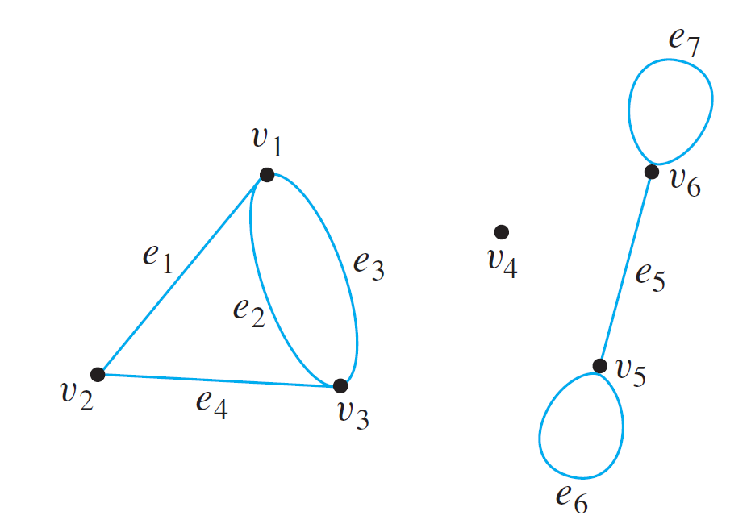
Graphs: Definitions Trails, Paths, and Circuits Matrix Representations Planar Graphs
Graphs: Definitions and Basic Properties
Graphs: Definitions and Basic Properties
Example: Consider the following graph:
Write the vertex set V and the edge set E, and give the list of edges with their end-points.
V = {v₁, v₂, v₃, v₄, v₅, v₆}
E = {e₁, e₂, e₃, e₄, e₅, e₆, e₇}
e₁ = {v₁, v₂}
e₂ = {v₁, v₃}
e₃ = {v₁, v₃}
e₄ = {v₂, v₃}
e₅ = {v₅, v₆}
e₆ = {v₅}
e₇ = {v₆}

Slide 11
Graphs: Definitions Trails, Paths, and Circuits Matrix Representations Planar Graphs
Graphs: Definitions and Basic Properties
Graphs: Definitions and Basic Properties
Example: Consider the following graph:
Find all edges that are incident on v₁, all vertices that are adjacent to v₁, all edges that are adjacent to e₁, all loops, all parallel edges, all vertices that are adjacent to themselves, and all isolated vertices.
Edges incident on v₁: e₁, e₂ and e₃.
Vertices adjacent to v₁: v₂ and v₃.
Edges adjacent to e₁: e₂, e₃ and e₄.
Loops: e₆ and e₇.
e₂ and e₃ are parallel.
v₅ and v₆ are adjacent to themselves.
Isolated vertex: v₄.

Slide 12
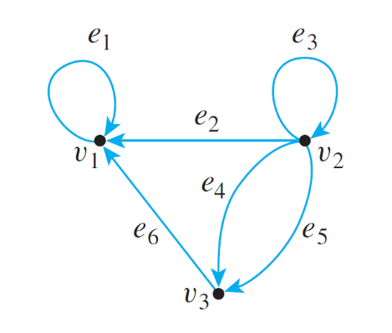
Graphs: Definitions Trails, Paths, and Circuits Matrix Representations Planar Graphs
Graphs: Definitions and Basic Properties
Graphs: Definitions and Basic Properties
Definition: Directed Graph
A directed graph, or digraph, G, consists of 2 finite sets: a nonempty set V(G) of vertices and a set D(G) of directed edges, where each edge is associated with an ordered pair of vertices called its endpoints.
If edge e is associated with the pair (v, w) of vertices, then e is said to be the (directed) edge from v to w. We write e = (v, w).
Undirected graph
Directed graph

Slide 13
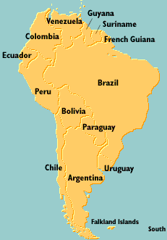
Graphs: Definitions Trails, Paths, and Circuits Matrix Representations Planar Graphs
Modelling Graph Problems
Modelling Graph Problems
Map Colouring Problem
Solve it as a graph problem.
Draw a graph in which the vertices represent the states, with every edge joining two vertices represents the states sharing a common border.
Such two vertices cannot be coloured with the same colour.
A vertex colouring of a graph is an assignment of colours to vertices so that no two adjacent vertices have the same colour.

Slide 14
Graphs: Definitions Trails, Paths, and Circuits Matrix Representations Planar Graphs
Modelling Graph Problems
Modelling Graph Problems
Guy
Ven
Sur
Col
Fre
Bra
Ecu
Per
Bol
Par
Chi
Uru
Arg
Fal

Slide 15
Graphs: Definitions Trails, Paths, and Circuits Matrix Representations Planar Graphs
Modelling Graph Problems
Modelling Graph Problems
Guy
Ven
Sur
Col
Fre
Bra
Ecu
Per
Bol
Par
Chi
Uru
Arg
Fal


Slide 16

Graphs: Definitions Trails, Paths, and Circuits Matrix Representations Planar Graphs
Modelling Graph Problems
Wedding Planner
You are your best friend’s wedding planner and you need to plan the seating arrangement for his 16 guests attending his wedding dinner. However, some of the guests cannot get along with some others.
A doesn’t get along with F, G or H.
B doesn’t get along with C, D or H.
C doesn’t get along with B, D, E, G or H.
D doesn’t get along with B, C or E.
E doesn’t get along with C, D, F, or G.
F doesn’t get along with A, E or G.
G doesn’t get along with A, C, E or F.
H doesn’t get along with A, B or C.
You don’t want to put guests who cannot get along with each other at the same table!
How many tables do you need?
Acknowledgement: http://www.math.uri.edu/~eaton/0131873814_MEb.pdf

Slide 17
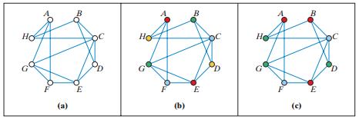
Graphs: Definitions Trails, Paths, and Circuits Matrix Representations Planar Graphs
Modelling Graph Problems
A doesn’t get along with F, G or H.
B doesn’t get along with C, D or H.
C doesn’t get along with B, D, E, G or H.
D doesn’t get along with B, C or E.
E doesn’t get along with C, D, F, or G.
F doesn’t get along with A, E or G.
G doesn’t get along with A, C, E or F.
H doesn’t get along with A, B or C.
Wedding Planner
Graph with vertices representing the guests, and an edge is drawn between two guests who don’t get along.
Vertex colouring problem. 4 colours (4 tables)?

Acknowledgement: http://www.math.uri.edu/~eaton/0131873814_MEb.pdf

Slide 18
Graphs: Definitions Trails, Paths, and Circuits Matrix Representations Planar Graphs
Modelling Graph Problems
Other Vertex Colouring Problems
 | If the vertices represent… | And two vertices are adjacent if …. | Then a vertex colouring can be used to…
1. | classes, | the corresponding classes have students in common, | schedule classes.
2. | radio stations, | the stations are close enough to interfere with each other, | assign non-interfering frequencies to the stations.
3. | traffic signals at an intersection, | the corresponding signals cannot be green at the same time, | designate sets of signals that can be green at the same time.

Slide 19
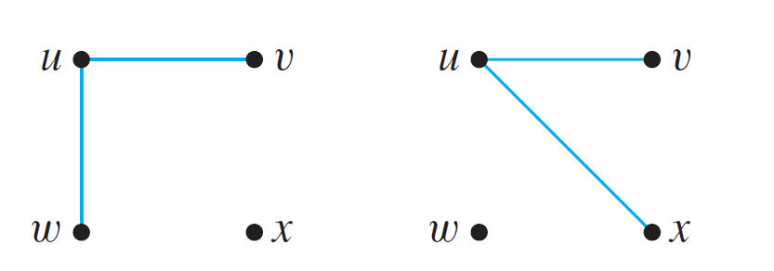

Graphs: Definitions Trails, Paths, and Circuits Matrix Representations Planar Graphs
Special Graphs
Simple Graphs
Definition: Simple Graph
A simple graph is an undirected graph that does not have any loops or parallel edges.
Example: Draw all simple graphs with the 4 vertices {u, v, w, x} and two edges, one of which is {u, v}.
There are at most $\left({4 \atop 2}\right)$ = 6 edges in a simple graph with 4 vertices. One edge is given. Hence we need to pick another from the remaining 5.
Draw the rest.


Slide 20
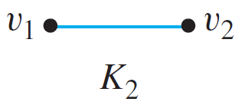
Graphs: Definitions Trails, Paths, and Circuits Matrix Representations Planar Graphs
Special Graphs
Complete Graphs
Definition: Complete Graph
A complete graph on n vertices, n > 0, denoted K_{n}, is a simple graph with n vertices and exactly one edge connecting each pair of distinct vertices .
Example: The complete graphs K₁, K₂, K₃ and K₄.
Draw K₅.


Slide 21
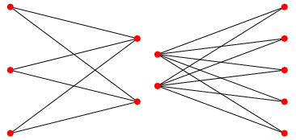
Graphs: Definitions Trails, Paths, and Circuits Matrix Representations Planar Graphs
Special Graphs
Complete Bipartite Graphs
Definition: Complete Bipartite Graph
A complete bipartite graph on (m, n) vertices, where m, n > 0, denoted K_{m,n}, is a simple graph with distinct vertices v₁, v₂,…, v_{m}, and w₁, w₂,…, w_{n} that satisfies the following properties:
For all i, k = 1, 2, …, m and for all j, l = 1, 2, …, n,
There is an edge from each vertex v_{i} to each vertex w_{j}.
There is no edge from any vertex v_{i} to any other vertex v_{k}.
There is no edge from any vertex w_{j} to any other vertex w_{l}.
K_{3,2}
K_{2,5}

Slide 22
Graphs: Definitions Trails, Paths, and Circuits Matrix Representations Planar Graphs
Special Graphs
Subgraph of a Graph
Definition: Subgraph of a Graph
A graph H is said to be a subgraph of graph G if, and only if, every vertex in H is also a vertex in G, every edge in H is also an edge in G, and every edge in H has the same endpoints as it has in G.
A graph G
A subgraph of G

Slide 23
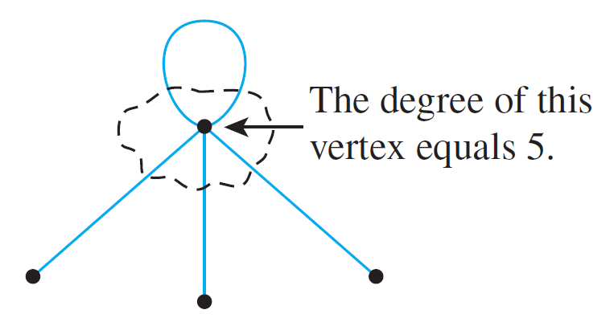
Graphs: Definitions Trails, Paths, and Circuits Matrix Representations Planar Graphs
The Concept of Degree
Degree of a Vertex and Total Degree of a Graph
Definition: Degree of a Vertex and Total Degree of a Graph
Let G be a graph and v a vertex of G. The degree of v, denoted deg(v), equals the number of edges that are incident on v, with an edge that is a loop counted twice.
The total degree of G is the sum of the degrees of all the vertices of G.
The degree of a vertex can be obtained from the drawing of a graph by counting how many end segments of edges are incident on the vertex.

Slide 24
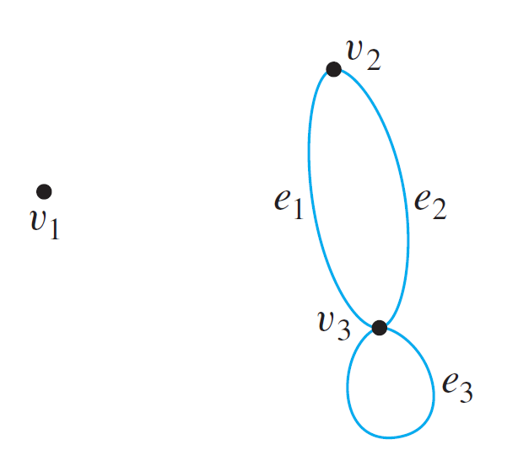
Graphs: Definitions Trails, Paths, and Circuits Matrix Representations Planar Graphs
The Concept of Degree
Degree of a Vertex and Total Degree of a Graph
Example: Find the degree of each vertex of the graph G shown below. Then find the total degree of G.
deg(v₁) = 0
deg(v₂) = 2
deg(v₃) = 4
Total degree of G = 6

Slide 25
Graphs: Definitions Trails, Paths, and Circuits Matrix Representations Planar Graphs
The Concept of Degree
Theorem 10.1.1 The Handshake Theorem
If G is any graph, then the sum of the degrees of all the vertices of G equals twice the number of edges of G. Specifically, if the vertices of G are v₁, v₂, …, v_{n}, where n ≥ 0, then
The total degree of G = deg(v₁) + deg(v₂) + … + deg(v_{n})
= 2 × (the number of edges of G).
Corollary 10.1.2
The total degree of a graph is even.
Proposition 10.1.3
In any graph there are an even number of vertices of odd degree.

Slide 26
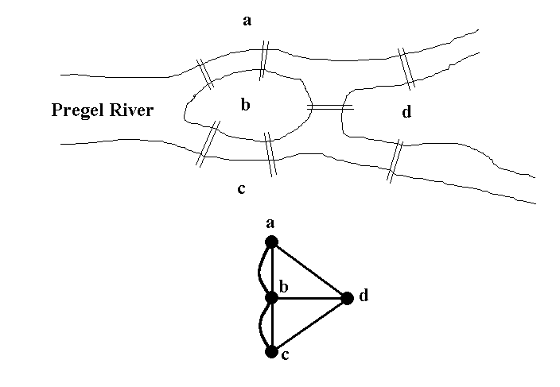
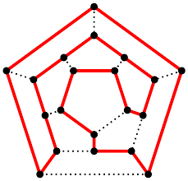
Graphs: Definitions Trails, Paths, and Circuits Matrix Representations Planar Graphs
10.2 Trails, Paths, and Circuits

Slide 27
Graphs: Definitions Trails, Paths, and Circuits Matrix Representations Planar Graphs
Introduction
Let’s Have Some Fun
Can you draw the following figures without lifting up your pencil?
(1)
(2)
(3)
(4)
(5)
(6)
(7)
(8)

Slide 28
Graphs: Definitions Trails, Paths, and Circuits Matrix Representations Planar Graphs
Introduction
Königsberg bridges
The subject of graph theory began in the year 1736 when the great mathematician Leonhard Euler published a paper giving the solution to the following puzzle:
The town of Königsberg in Prussia (now Kaliningrad in Russia) was built at a point where two branches of the Pregel River came together. It consisted of an island and some land along the river banks.
These were connected by 7 bridges.

Slide 29
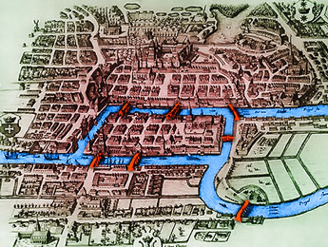
Graphs: Definitions Trails, Paths, and Circuits Matrix Representations Planar Graphs
Introduction
Königsberg bridges
Question: Is it possible to take a walk around town, starting and ending at the same location and crossing each of the 7 bridges exactly once?

Slide 30
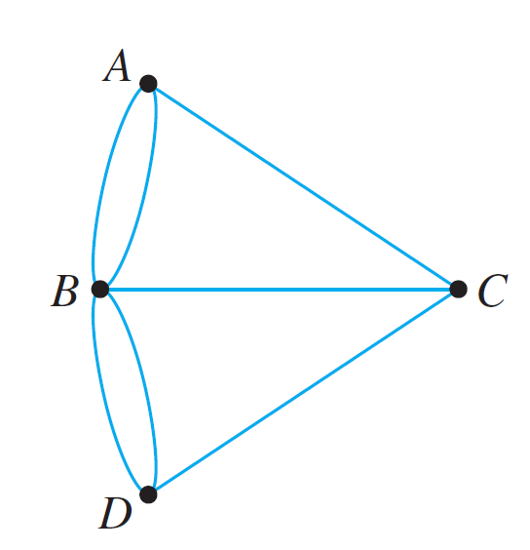
Graphs: Definitions Trails, Paths, and Circuits Matrix Representations Planar Graphs
Introduction
Königsberg bridges
In terms of this graph, the question is:
Is it possible to find a route through the graph that starts and ends at some vertex, one of A, B, C, or D, and traverses each edge exactly once?

Slide 31
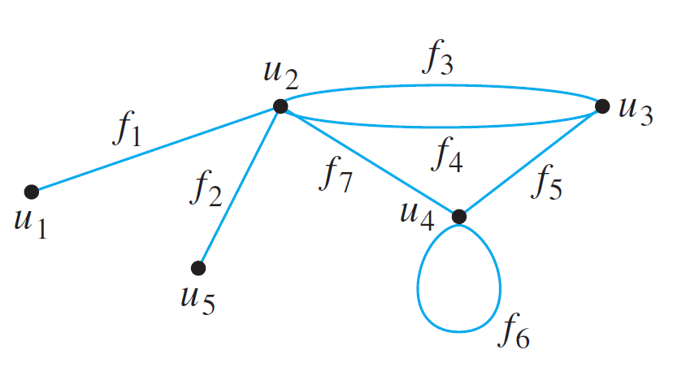
Graphs: Definitions Trails, Paths, and Circuits Matrix Representations Planar Graphs
Definitions
Definitions
Travel in a graph is accomplished by moving from one vertex to another along a sequence of adjacent edges.
In the graph below, for instance, you can go from u₁ to u₄ by taking f₁ to u₂ and then f₇ to u₄. This is represented by writing u₁ f₁ u₂ f₇ u₄.
Or, you could take a roundabout route:

Slide 32
Graphs: Definitions Trails, Paths, and Circuits Matrix Representations Planar Graphs
Definitions
Walk, Trail, Path, Closed Walk, Circuit, Simple Circuit
Definitions
Let G be a graph, and let v and w be vertices of G.
A walk from v to w is a finite alternating sequence of adjacent vertices and edges of G. Thus a walk has the form
v₀ e₁ v₁ e₂ … v_{n-1} e_{n} v_{n} ,
where the v’s represent vertices, the e’s represent edges, v₀=v, v_{n}=w, and for all i ∈ {1, 2, …, n}, v_{i-1} and v_{i} are the endpoints of e_{i}.
The trivial walk from v to v consists of the single vertex v.
A trail from v to w is a walk from v to w that does not contain a repeated edge.
A path from v to w is a trail that does not contain a repeated vertex.

Slide 33
Graphs: Definitions Trails, Paths, and Circuits Matrix Representations Planar Graphs
Definitions
Walk, Trail, Path, Closed Walk, Circuit, Simple Circuit
Definitions
A closed walk is a walk that starts and ends at the same vertex.
A circuit (or cycle) is a closed walk that contains at least one edge and does not contain a repeated edge.
A simple circuit (or simple cycle) is a circuit that does not have any other repeated vertex except the first and last.

Slide 34
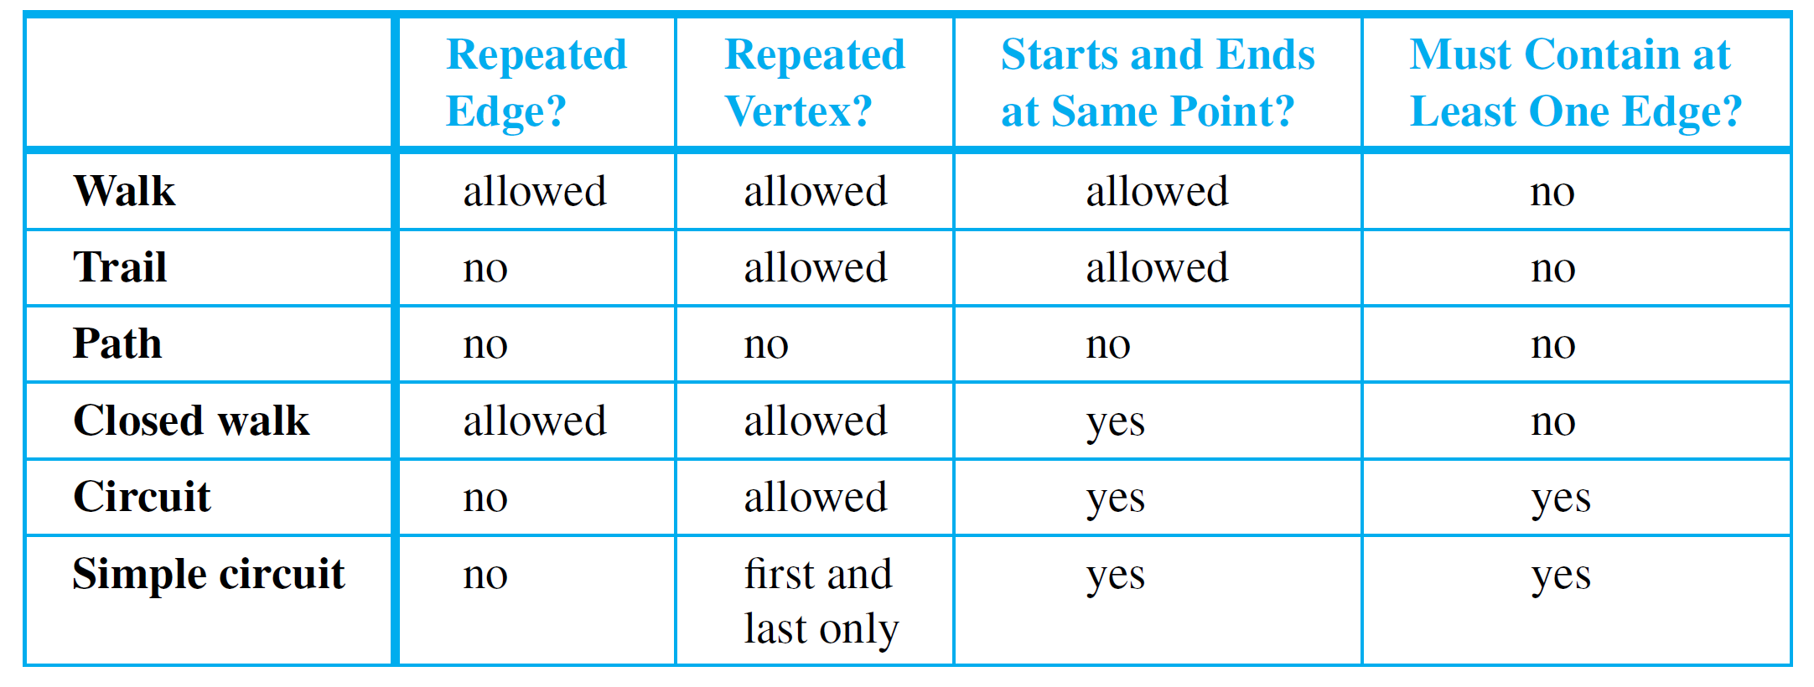
Graphs: Definitions Trails, Paths, and Circuits Matrix Representations Planar Graphs
Definitions
Walk, Trail, Path, Closed Walk, Circuit, Simple Circuit
Often a walk can be specified unambiguously by giving either a sequence of edges or a sequence of vertices.

Slide 35
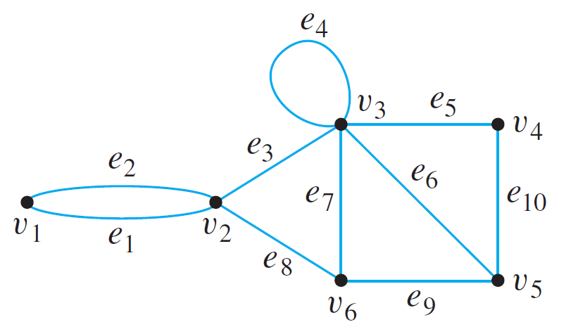






Graphs: Definitions Trails, Paths, and Circuits Matrix Representations Planar Graphs
Definitions
Walk, Trail, Path, Closed Walk, Circuit, Simple Circuit
In this graph, determine which of the following walks are trails, paths, circuits, or simple circuits.
a.
Trail; not a path.
b.
Walk; not a trail.
c.
Circuit; not a simple circuit.
d.
e.
f.


Slide 36
Graphs: Definitions Trails, Paths, and Circuits Matrix Representations Planar Graphs
Definitions
Notes
Because most of the major developments in graph theory have happened relatively recently and in a variety of different contexts, the terms used in the subject have not been standardized.
Susanna Epp’s book | Others
Graph | Multigraph
Simple graph | Graph
Vertex | Node
Edge | Arc
Trail | Path
Path | Simple path
Simple circuit | Cycle
The terminology in this book is among the most common, but if you consult other sources, be sure to check their definitions.
For CS1231, we will follow the terminology in Epp’s book.

Slide 37
Graphs: Definitions Trails, Paths, and Circuits Matrix Representations Planar Graphs
Connectedness
Connectedness
A graph is connected if it is possible to travel from any vertex to any other vertex along a sequence of adjacent edges of the graph.
Definition: Connectedness
Two vertices v and w of a graph G are connected if, and only if, there is a walk from v to w.
The graph G is connected if, and only if, given any two vertices v and w in G, there is a walk from v to w. Symbolically,
G is connected iff ∀ vertices v, w ∈V(G), ∃ a walk from v to w.

Slide 38
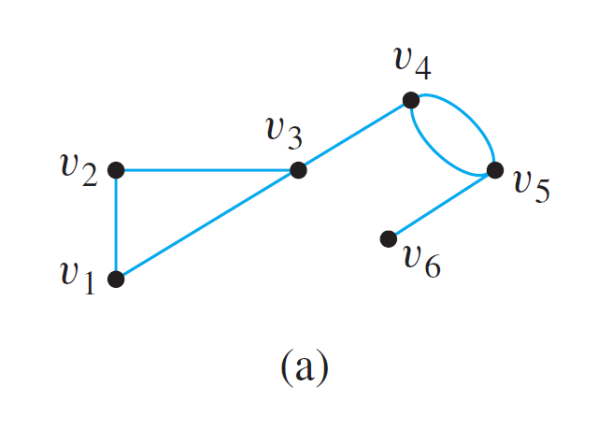
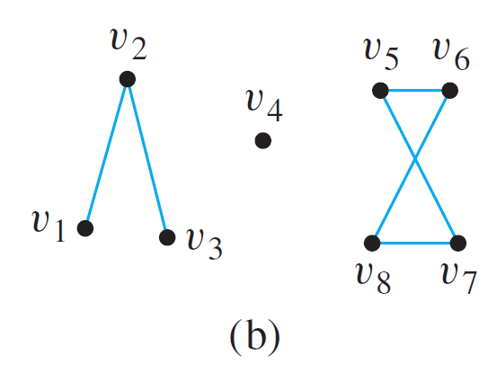
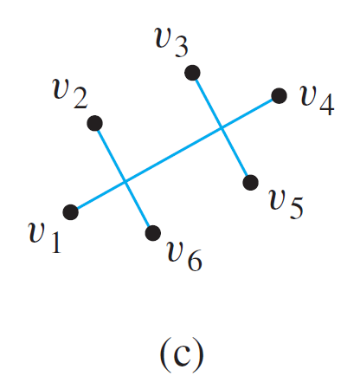
Graphs: Definitions Trails, Paths, and Circuits Matrix Representations Planar Graphs
Connectedness
Example: Which of the following graphs are connected?


Slide 39
Graphs: Definitions Trails, Paths, and Circuits Matrix Representations Planar Graphs
Connectedness
Some useful facts relating circuits and connectedness are collected in the following lemma.
Lemma 10.2.1
Let G be a graph.
If G is connected, then any two distinct vertices of G can be connected by a path.
If vertices v and w are part of a circuit in G and one edge is removed from the circuit, then there still exists a trail from v to w in G.
If G is connected and G contains a circuit, then an edge of the circuit can be removed without disconnecting G.

Slide 40
Graphs: Definitions Trails, Paths, and Circuits Matrix Representations Planar Graphs
Connected Component
Connected Component
The graphs in (b) and (c) are both made up of three pieces, each of which is itself a connected graph.
A connected component of a graph is a connected subgraph of largest possible size.

Slide 41
Graphs: Definitions Trails, Paths, and Circuits Matrix Representations Planar Graphs
Connected Component
Definition: Connected Component
A graph H is a connected component of a graph G if, and only if,
The graph H is a subgraph of G;
The graph H is connected; and
No connected subgraph of G has H has a subgraph and contains vertices or edges that are not in H.
The fact is that any graph is a kind of union of its connected components.

Slide 42
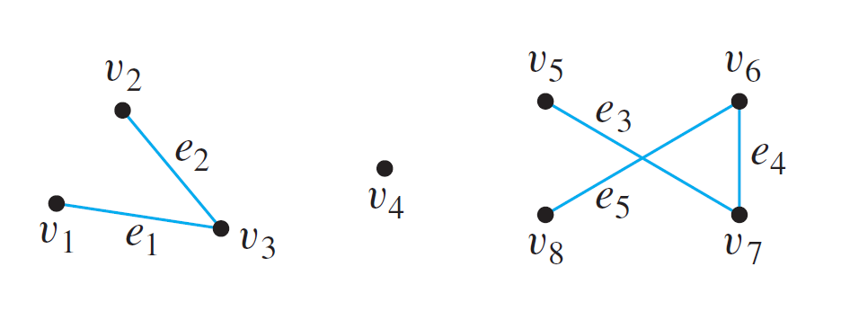
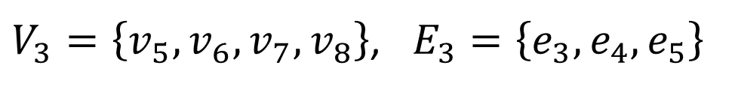
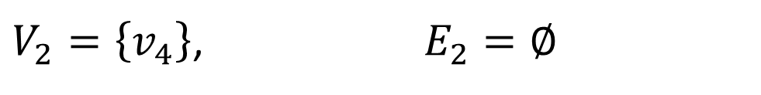
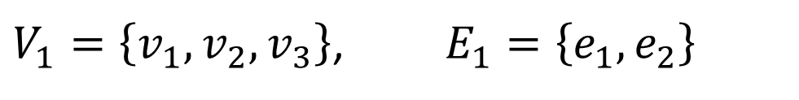
Graphs: Definitions Trails, Paths, and Circuits Matrix Representations Planar Graphs
Connected Component
Find all connected components of the following graph G.
G has 3 connected components H₁, H₂ and H₃ with vertex sets V₁, V₂ and V₃ and edge sets E₁, E₂ and E₃ , where
$V_{1}=\left\{v_{1},v_{2},v_{3}\right\}$, $E_{1}=\left\{e_{1},e_{2}\right\}$
$V_{2}=\left\{v_{4}\right\}$, $E_{2}=∅$
$V_{3}=\left\{v_{5},v_{6},v_{7},v_{8}\right\}$, $E_{3}=\left\{e_{3},e_{4},e_{5}\right\}$

Slide 43
Graphs: Definitions Trails, Paths, and Circuits Matrix Representations Planar Graphs
Euler Circuits
Euler Circuits
Now, let’s go back to the puzzle of the Königsberg bridges.
Is it possible to find a route through the graph that starts and ends at some vertex, one of A, B, C, or D, and traverses each edge exactly once?

Slide 44
Graphs: Definitions Trails, Paths, and Circuits Matrix Representations Planar Graphs
Euler Circuits
Definition: Euler Circuit
Let G be a graph. An Euler circuit for G is a circuit that contains every vertex and every edge of G.
That is, an Euler circuit for G is a sequence of adjacent vertices and edges in G that has at least one edge, starts and ends at the same vertex, uses every vertex of G at least once, and uses every edge of G exactly once.
Definition: Eulerian Graph
An Eulerian graph is a graph that contains an Euler circuit.

Slide 45
Graphs: Definitions Trails, Paths, and Circuits Matrix Representations Planar Graphs
Euler Circuits
Theorem 10.2.2
If a graph has an Euler circuit, then every vertex of the graph has positive even degree.
Contrapositive Version of Theorem 10.2.2
If some vertex of a graph has odd degree, then the graph does not have an Euler circuit.

Slide 46
Graphs: Definitions Trails, Paths, and Circuits Matrix Representations Planar Graphs
Euler Circuits
Does each of the following graphs have an Euler circuit?
(1)
(2)
(3)
(4)
(5)
(6)
(7)
(8)


Slide 47
Graphs: Definitions Trails, Paths, and Circuits Matrix Representations Planar Graphs
Euler Circuits
Is the converse of Theorem 10.2.2 true?
If every vertex of a graph has even degree, then the graph has an Euler circuit.


Slide 48
Graphs: Definitions Trails, Paths, and Circuits Matrix Representations Planar Graphs
Euler Circuits
Theorem 10.2.3
If a graph G is connected and the degree of every vertex of G is a positive even integer, then G has an Euler circuit.
The proof of Theorem 10.2.3 is constructive: It contains an algorithm to find an Euler circuit for any connected graph in which every vertex has even degree.
Theorem 10.2.4
A graph G has an Euler circuit if, and only if, G is connected and every vertex of G has positive even degree.
A corollary to Theorem 10.2.4 gives a criterion for determining when it is possible to find a walk from one vertex of a graph to another, passing through every vertex of the graph at least once and every edge of the graph exactly once.

Slide 49
Graphs: Definitions Trails, Paths, and Circuits Matrix Representations Planar Graphs
Euler Circuits
Definition: Euler Trail
Let G be a graph, and let v and w be two distinct vertices of G. An Euler trail/path from v to w is a sequence of adjacent edges and vertices that starts at v, ends at w, passes through every vertex of G at least once, and traverses every edge of G exactly once.
Corollary 10.2.5
Let G be a graph, and let v and w be two distinct vertices of G. There is an Euler trail from v to w if, and only if, G is connected, v and w have odd degree, and all other vertices of G have positive even degree.

Slide 50
Graphs: Definitions Trails, Paths, and Circuits Matrix Representations Planar Graphs
Euler Circuits
The following graphs do not have an Euler circuit. Do they have an Euler trail?
(1)
(5)


Slide 51
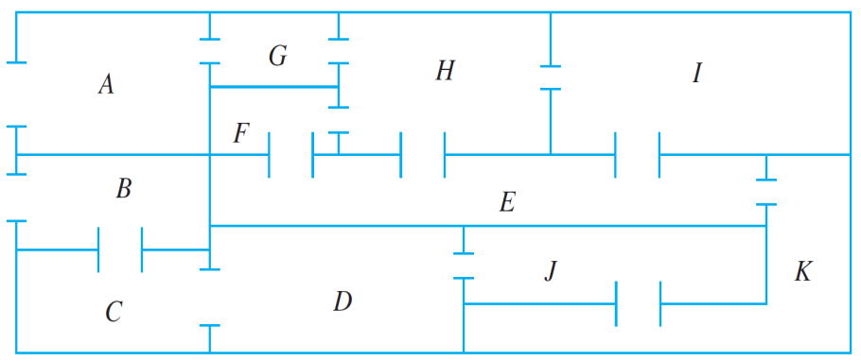
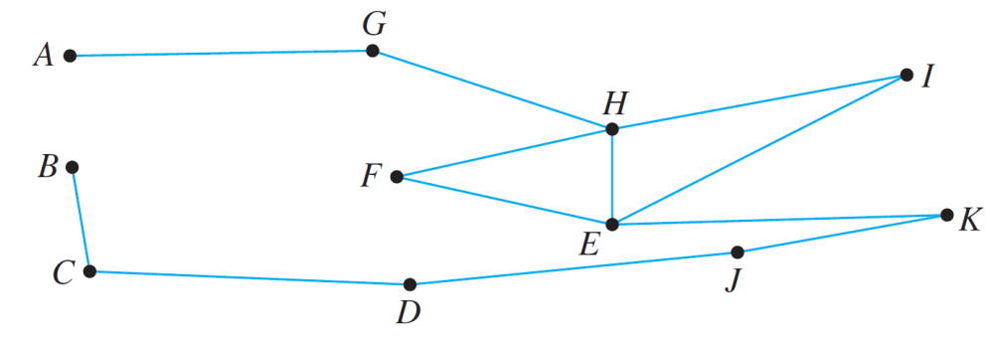
Graphs: Definitions Trails, Paths, and Circuits Matrix Representations Planar Graphs
Euler Circuits
The floor plan shown below is for a house that is open for public viewing. Is it possible to find a trail that starts in room A, ends in room B, and passes through every interior doorway of the house exactly once? If so, find such a trail.
Each vertex of this graph has even degree except for A and B, each of which has degree 1.
Hence by Corollary 10.2.5, there is an Euler path from A to B. One such trail is AGHFEIHEKJDCB.

Slide 52
Graphs: Definitions Trails, Paths, and Circuits Matrix Representations Planar Graphs
Hamiltonian Circuits
Hamiltonian Circuits
Recall Theorem 10.2.4:
Theorem 10.2.4
A graph G has an Euler circuit if, and only if, G is connected and every vertex of G has positive even degree.
A related question:
Given a graph G, is it possible to find a circuit for G in which all the vertices of G (except the first and the last) appear exactly once?

Slide 53
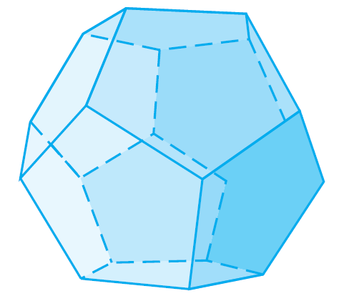
Graphs: Definitions Trails, Paths, and Circuits Matrix Representations Planar Graphs
Hamiltonian Circuits
In 1859 the Irish mathematician Sir William Rowan Hamilton introduced a puzzle in the shape of a dodecahedron (DOH-dek-a-HEE-dron). (Figure 10.2.6 contains a drawing of a dodecahedron, which is a solid figure with 12 identical pentagonal faces.)
Figure 10.2.6 Dodecahedron

Slide 54
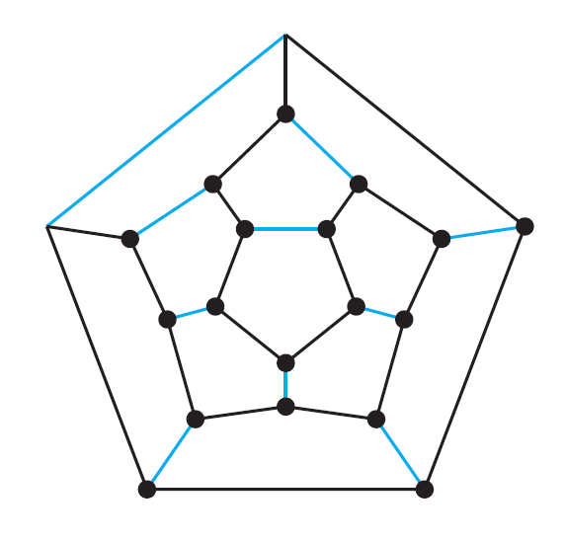
Graphs: Definitions Trails, Paths, and Circuits Matrix Representations Planar Graphs
Hamiltonian Circuits
Each vertex was labeled with the name of a city —London, Paris, Hong Kong, New York, and so on.
The problem Hamilton posed was to start at one city and tour the world by visiting each other city exactly once and returning to the starting city.
One way to solve the puzzle is to imagine the surface of the dodecahedron stretched out and laid flat in the plane, as follows:

Slide 55
Graphs: Definitions Trails, Paths, and Circuits Matrix Representations Planar Graphs
Hamiltonian Circuits
The circuit denoted with black lines is one solution. Note that although every city is visited, many edges are omitted from the circuit. (More difficult versions of the puzzle required that certain cities be visited in a certain order.)

Slide 56
Graphs: Definitions Trails, Paths, and Circuits Matrix Representations Planar Graphs
Hamiltonian Circuits
Definition: Hamiltonian Circuit
Given a graph G, a Hamiltonian circuit for G is a simple circuit that includes every vertex of G.
That is, a Hamiltonian circuit for G is a sequence of adjacent vertices and distinct edges in which every vertex of G appears exactly once, except for the first and the last, which are the same.
Definition: Hamiltonian Graph
A Hamiltonian graph (also called Hamilton graph) is a graph that contains a Hamiltonian circuit.

Slide 57
Graphs: Definitions Trails, Paths, and Circuits Matrix Representations Planar Graphs
Hamiltonian Circuits
Note that although an Euler circuit for a graph G must include every vertex of G, it may visit some vertices more than once and hence may not be a Hamiltonian circuit.
On the other hand, a Hamiltonian circuit for G does not need to include all the edges of G and hence may not be an Euler circuit.
Despite the analogous-sounding definitions of Euler and Hamiltonian circuits, the mathematics of the two are very different.

Slide 58
Graphs: Definitions Trails, Paths, and Circuits Matrix Representations Planar Graphs
Hamiltonian Circuits
Theorem 10.2.4 gives a simple criterion for determining whether a given graph has an Euler circuit.
Unfortunately, there is no analogous criterion for determining whether a given graph has a Hamiltonian circuit, nor is there even an efficient algorithm for finding such a circuit.
Theorem 10.2.4
A graph G has an Euler circuit if, and only if, G is connected and every vertex of G has positive even degree.

Slide 59
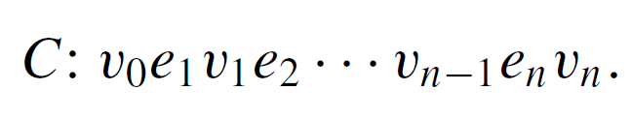
Graphs: Definitions Trails, Paths, and Circuits Matrix Representations Planar Graphs
Hamiltonian Circuits
There is, however, a simple technique that can be used in many cases to show that a graph does not have a Hamiltonian circuit.
This follows from the following considerations:
Suppose a graph G with at least two vertices has a Hamiltonian circuit C given concretely as
Since C is a simple circuit, all the e_{i} are distinct and all the v_{j} are distinct except that v₀ = v_{n}. Let H be the subgraph of G that is formed using the vertices and edges of C.

Slide 60
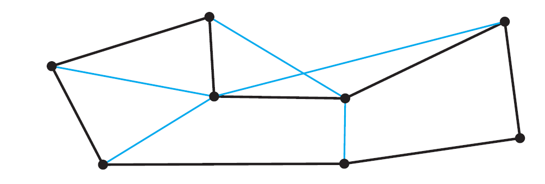
Graphs: Definitions Trails, Paths, and Circuits Matrix Representations Planar Graphs
Hamiltonian Circuits
An example of such an H is shown below.
H is indicated by the black lines.
Note that H has the same number of edges as it has vertices since all its n edges are distinct and so are its n vertices v₁, v₂, . . . , v_{n}.
Also, by definition of Hamiltonian circuit, every vertex of G is a vertex of H, and H is connected since any two of its vertices lie on a circuit. In addition, every vertex of H has degree 2.
The reason for this is that there are exactly two edges incident on any vertex. These are e_{i} and e_{i+1} for any vertex v_{i} except v₀=v_{n}, and they are e₁ and e_{n} for v₀ (=v_{n}).

Slide 61
Graphs: Definitions Trails, Paths, and Circuits Matrix Representations Planar Graphs
Hamiltonian Circuits
These observations have established the truth of the following proposition in all cases where G has at least two vertices.
Proposition 10.2.6
If a graph G has a Hamiltonian circuit, then G has a subgraph H with the following properties:
H contains every vertex of G.
H is connected.
H has the same number of edges as vertices.
Every vertex of H has degree 2.
The contrapositive of Proposition 10.2.6 says that if a graph G does not have a subgraph H with properties (1)–(4), then G does not have a Hamiltonian circuit.

Slide 62
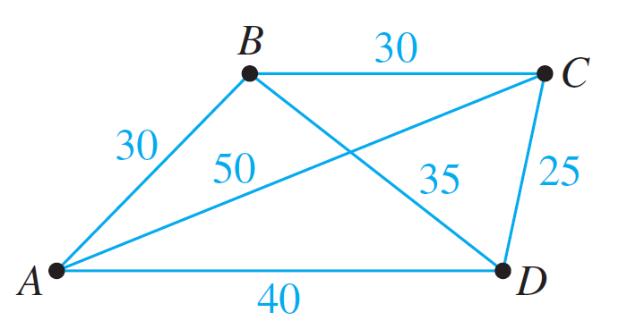
Graphs: Definitions Trails, Paths, and Circuits Matrix Representations Planar Graphs
Travelling Salesman Problem
Travelling Salesman Problem
Imagine that the drawing below is a map showing four cities and the distances in kilometers between them.
Suppose that a salesman must travel to each city exactly once, starting and ending in city A. Which route from city to city will minimize the total distance that must be travelled?

Slide 63
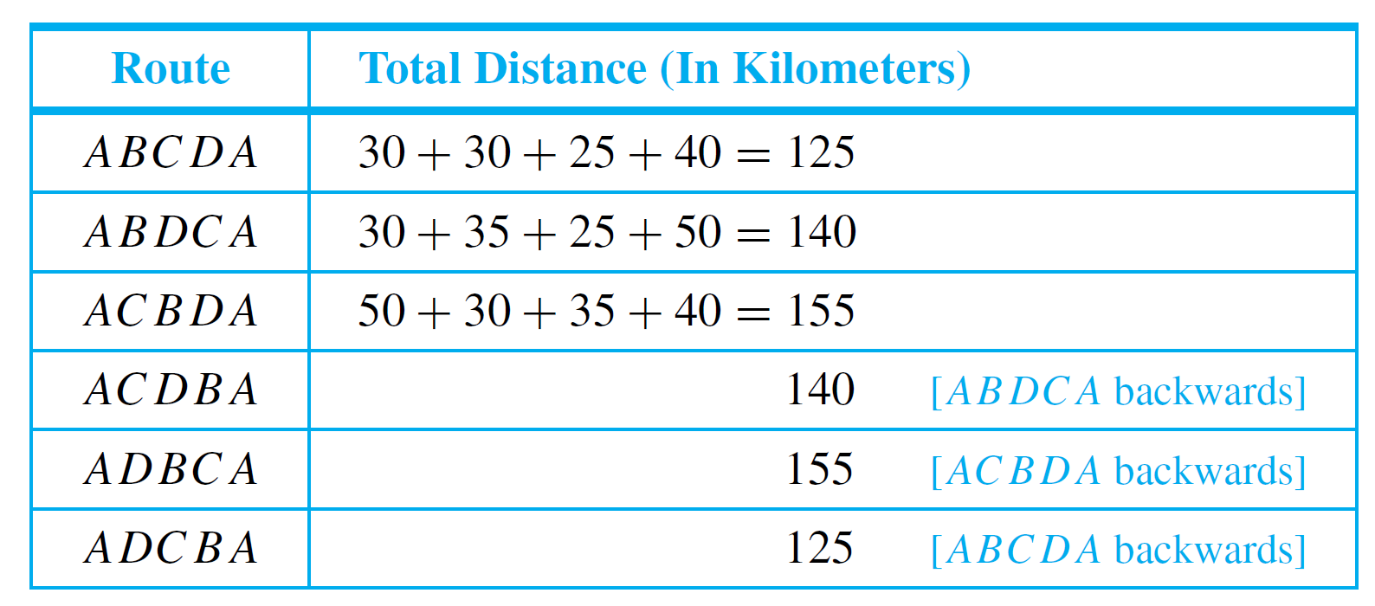
Graphs: Definitions Trails, Paths, and Circuits Matrix Representations Planar Graphs
Travelling Salesman Problem
This problem can be solved by writing all possible Hamiltonian circuits starting and ending at A and calculating the total distance travelled for each.
Thus either route ABCDA or ADCBA gives a minimum total distance of 125 km.

Slide 64
Graphs: Definitions Trails, Paths, and Circuits Matrix Representations Planar Graphs
Travelling Salesman Problem
The general travelling salesman problem involves finding a Hamiltonian circuit to minimize the total distance travelled for an arbitrary graph with n vertices in which each edge is marked with a distance.
One way to solve the general problem is to use the previous method: Write down all Hamiltonian circuits starting and ending at a particular vertex, compute the total distance for each, and pick one for which this total is minimal.
However, this is impractical for even medium-sized values of n. For n = 30 vertices, there would be (29!)/2 ≈ 4.42×10³⁰ Hamiltonian circuits starting and ending at a particular vertex to check. If each circuit could be found and its total distance computed in just one nanosecond, it would take approximately 1.4 ×10¹⁴ years to compute!

Slide 65
Graphs: Definitions Trails, Paths, and Circuits Matrix Representations Planar Graphs
Travelling Salesman Problem
At present, there is no known algorithm for solving the general travelling salesman problem that is more efficient.
However, there are efficient algorithms that find “pretty good” solutions — that is, circuits that, while not necessarily having the least possible total distances, have smaller total distances than most other Hamiltonian circuits.

Slide 66
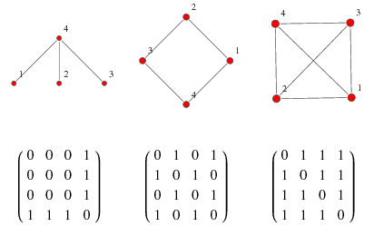
Graphs: Definitions Trails, Paths, and Circuits Matrix Representations Planar Graphs
10.3 Matrix Representations of Graphs

Slide 67
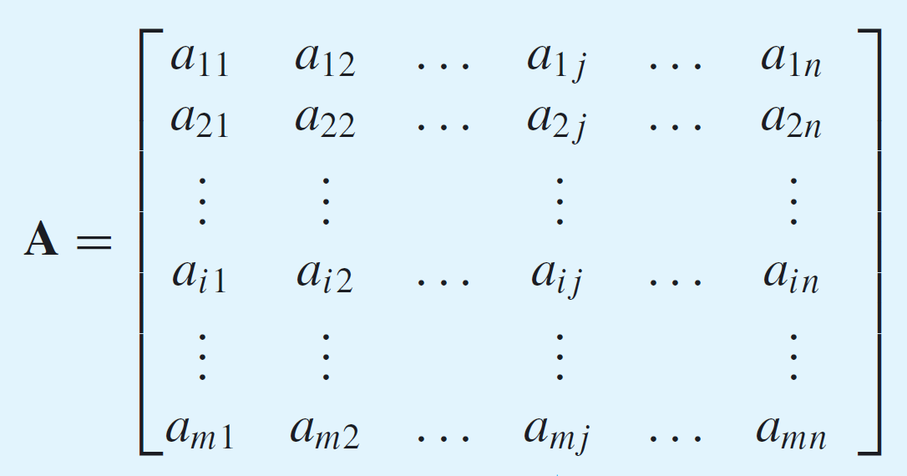

Graphs: Definitions Trails, Paths, and Circuits Matrix Representations Planar Graphs
Matrix Representations of Graphs
Matrices
Definition: Matrix
An m × n (read “m by n”) matrix A over a set S is a rectangular array of elements of S arranged into m rows and n columns.
We write A = ($a_{ij}$).
ith row of A
jth column of A

Slide 68
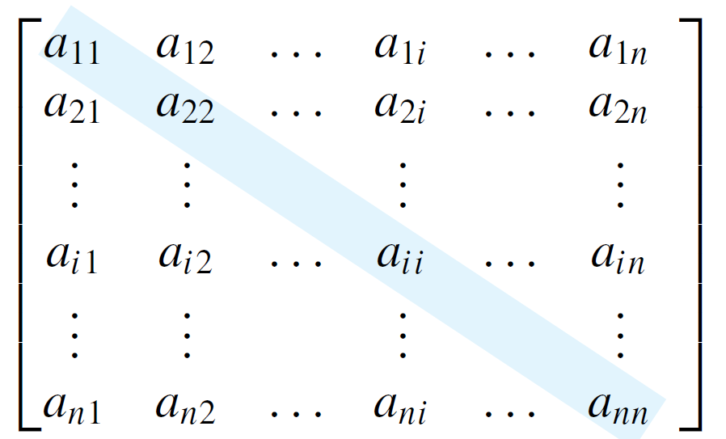
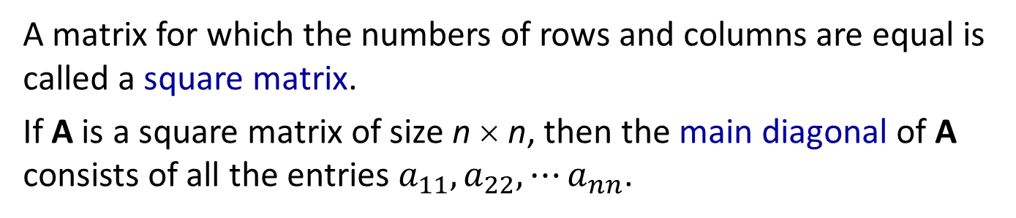
Graphs: Definitions Trails, Paths, and Circuits Matrix Representations Planar Graphs
Matrices
If A and B are matrices, then A = B if, and only if, A and B have the same size and the corresponding entries of A and B are all equal; that is,
$a_{ij}=b_{ij}$ for all $i=1, 2, ⋯, m$ and $j=1, 2, ⋯, n$.
A matrix for which the numbers of rows and columns are equal is called a square matrix.
If A is a square matrix of size n × n, then the main diagonal of A consists of all the entries $a_{11},a_{22},⋯a_{nn}$.
main diagonal of A

Slide 69

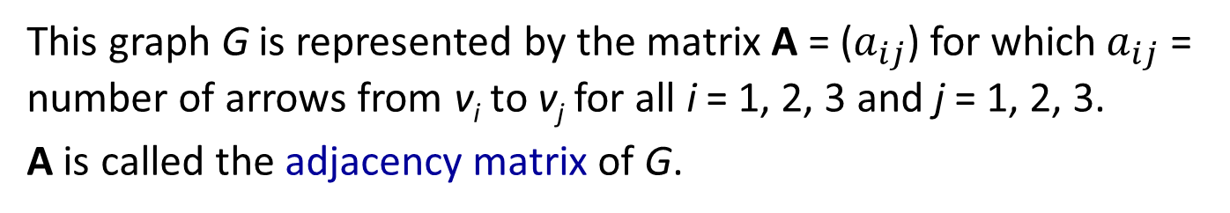
Graphs: Definitions Trails, Paths, and Circuits Matrix Representations Planar Graphs
Matrices and Directed Graphs
Matrices and Directed Graphs
Figure 10.3.1 A Directed Graph and Its Adjacency Matrix
This graph G is represented by the matrix A = ($a_{ij}$) for which${ a}_{ij}$ = number of arrows from v_{i} to v_{j} for all i = 1, 2, 3 and j = 1, 2, 3.
A is called the adjacency matrix of G.
Another common representation of a graph is the adjacency list, which is covered in algorithms module.

Slide 70
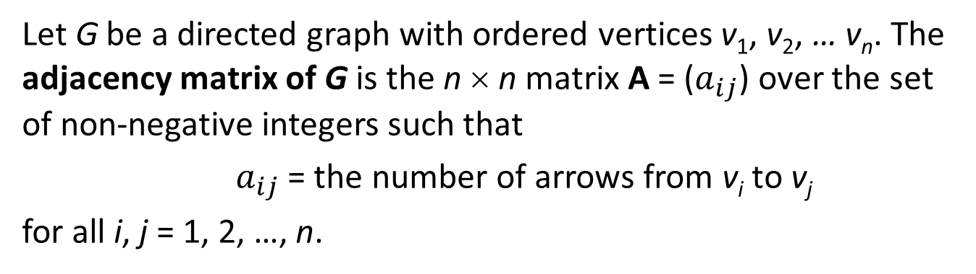
Graphs: Definitions Trails, Paths, and Circuits Matrix Representations Planar Graphs
Matrices and Directed Graphs
Definition: Adjacency Matrix of a Directed Graph
Let G be a directed graph with ordered vertices v₁, v₂, … v_{n}. The adjacency matrix of G is the n × n matrix A = ($a_{ij}$) over the set of non-negative integers such that
$a_{ij}$ = the number of arrows from v_{i} to v_{j}
for all i, j = 1, 2, …, n.

Slide 71
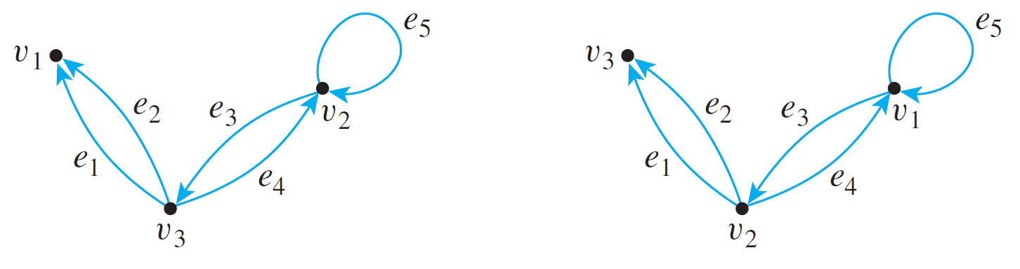
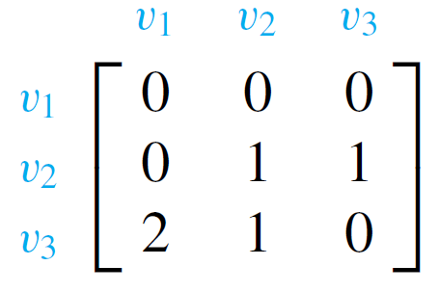
Graphs: Definitions Trails, Paths, and Circuits Matrix Representations Planar Graphs
Matrices and Directed Graphs
Example: Find the adjacency matrices of the two directed graphs below.
(a)
(b)
(a)


Slide 72
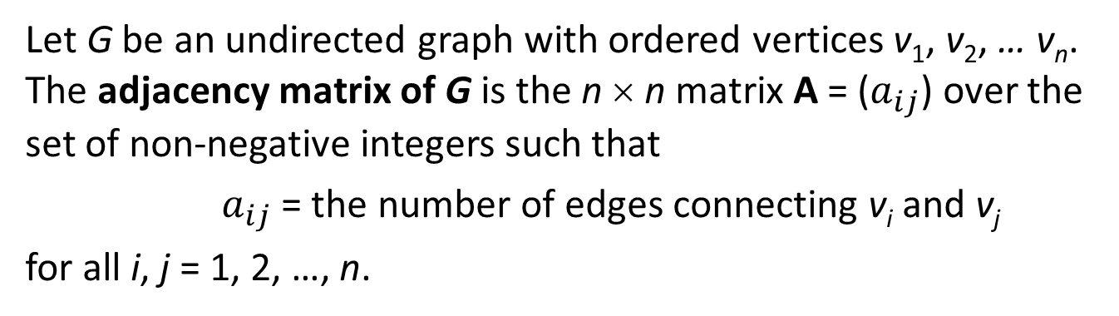
Graphs: Definitions Trails, Paths, and Circuits Matrix Representations Planar Graphs
Matrices and Undirected Graphs
Matrices and Undirected Graphs
Definition: Adjacency Matrix of an Undirected Graph
Let G be an undirected graph with ordered vertices v₁, v₂, … v_{n}. The adjacency matrix of G is the n × n matrix A = ($a_{ij}$) over the set of non-negative integers such that
$a_{ij}$ = the number of edges connecting v_{i} and v_{j}
for all i, j = 1, 2, …, n.

Slide 73
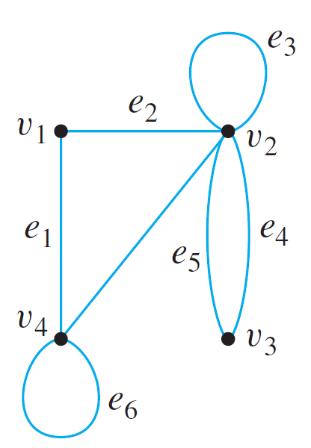
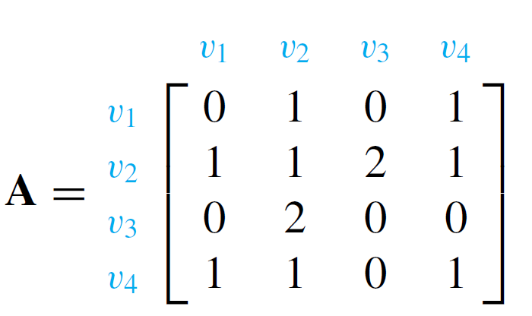
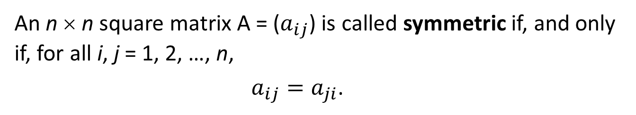
Graphs: Definitions Trails, Paths, and Circuits Matrix Representations Planar Graphs
Matrices and Undirected Graphs
Example: Find the adjacency matrix for the graph G shown below.
Note that the matrix is symmetric.
Definition: Symmetric Matrix
An n × n square matrix A = ($a_{ij}$) is called symmetric if, and only if, for all i, j = 1, 2, …, n,
$a_{ij}=a_{ji}$.

Slide 74
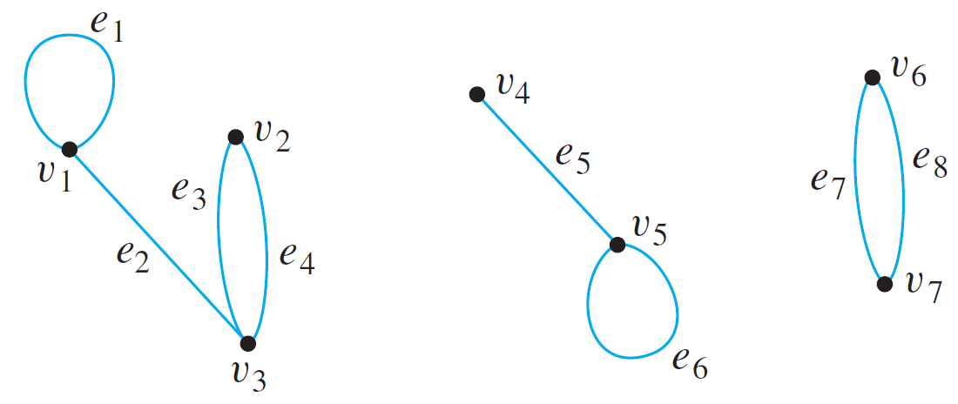

Graphs: Definitions Trails, Paths, and Circuits Matrix Representations Planar Graphs
Matrices and Connected Components
Matrices and Connected Components
Consider a graph G, as shown below, that consists of several connected components.
Adjacency matrix of G:

Slide 75
Graphs: Definitions Trails, Paths, and Circuits Matrix Representations Planar Graphs
Matrices and Connected Components
As you can see, A consists of square matrix blocks (of different sizes) down its diagonal and blocks of 0’s everywhere else.
The reason is that vertices in each connected component share no edges with vertices in other connected components.
For instance, since v₁, v₂, and v₃ share no edges with v₄, v₅, v₆, or v₇, all entries in the top three rows to the right of the third column are 0 and all entries in the left three columns below the third row are also 0.

Slide 76

Graphs: Definitions Trails, Paths, and Circuits Matrix Representations Planar Graphs
Matrices and Connected Components
Sometimes matrices whose entries are all 0’s are themselves denoted 0. If this convention is followed here, A is written as:

Slide 77

Graphs: Definitions Trails, Paths, and Circuits Matrix Representations Planar Graphs
Matrices and Connected Components
The previous reasoning can be generalized to prove the following theorem:
Theorem 10.3.1
Let G be a graph with connected components G₁, G₁, …, G_{k}. If there are n_{i} vertices in each connected component G_{i} and these vertices are numbered consecutively, then the adjacency matrix of G has the form:
$$\left[\begin{matrix}\begin{matrix}A_{1} & O & O \\ O & A_{2} & O \\ O & O & A_{3}\end{matrix} & ⋯ & \begin{matrix}O & O \\ O & O \\ O & O\end{matrix} \\ ⋮ & & ⋮ \\ \begin{matrix}O & O & O\end{matrix} & ⋯ & \begin{matrix}O & A_{k}\end{matrix}\end{matrix}\right]$$
where each A_{i} is n_{i} × n_{i} adjacency matrix of G_{i}, for all i = 1, 2, …, k, and the O’s represent matrices whose entries are all 0s.

Slide 78

Graphs: Definitions Trails, Paths, and Circuits Matrix Representations Planar Graphs
Matrix Multiplication
Matrix Multiplication
Definition: Scalar Product
Suppose that all entries in matrices A and B are real numbers. If the number of elements, n, in the ith row of A equals the number of elements in the jth column of B, then the scalar product or dot product of the ith row of A and the jth column of B is the real number obtained as follows:
$$\left[\begin{matrix}\begin{matrix}a_{i1} & a_{i2}\end{matrix} & \begin{matrix}⋯ & a_{in}\end{matrix}\end{matrix}\right]\left[\begin{matrix}\begin{matrix}b_{1j} \\ b_{2j}\end{matrix} \\ \begin{matrix}⋮ \\ b_{nj}\end{matrix}\end{matrix}\right]= a_{i1}b_{1j}+a_{i2}b_{2j}+⋯+a_{in}b_{nj}.$$

Slide 79


Graphs: Definitions Trails, Paths, and Circuits Matrix Representations Planar Graphs
Matrix Multiplication
Definition: Matrix Multiplication
Let A = (a_{ij}) be an m × k matrix and B = (b_{ij}) an k × n matrix with real entries. The (matrix) product of A times B, denoted AB, is that matrix (c_{ij}) defined as follows:
where
$c_{ij}=a_{i1}b_{1j}+a_{i2}b_{2j}+⋯+a_{ik}b_{kj}=\sum_{r=1}^{k}{a_{ir}b_{rj}.}$
for all i = 1, 2, …, m and j = 1, 2, …, n.

Slide 80




Graphs: Definitions Trails, Paths, and Circuits Matrix Representations Planar Graphs
Matrix Multiplication
Example – Computing a Matrix Product
Solution:
2
3
where

Slide 81


Graphs: Definitions Trails, Paths, and Circuits Matrix Representations Planar Graphs
Matrix Multiplication
Example – Computing a Matrix Product
Solution:
2
3
-2
-1
where
–2

Slide 82

Graphs: Definitions Trails, Paths, and Circuits Matrix Representations Planar Graphs
Matrix Multiplication
Multiplication of real numbers is commutative, but matrix multiplication is not.
On the other hand, both real number and matrix multiplications are associative ((ab)c = a(bc), for all elements a, b, and c for which the products are defined).

Slide 83




Graphs: Definitions Trails, Paths, and Circuits Matrix Representations Planar Graphs
Matrix Multiplication
Identity Matrix
These computations show that acts as an identity on
the left side for multiplication with 2 × 3 matrices and that
acts as an identity on the right side for multiplication
with 3 × 3 matrices.

Slide 84

Graphs: Definitions Trails, Paths, and Circuits Matrix Representations Planar Graphs
Matrix Multiplication
Definition: Identity Matrix
For each positive integer n, the n × n identity matrix, denoted I_{n} = (δ_{ij}) or just I (if the size of the matrix is obvious from context), is the n × n matrix in which all the entries in the main diagonal are 1’s and all other entries are 0’s. In other words,
$δ_{ij}=\left\{\begin{aligned}1, if i=j \\ &0, if i≠j\end{aligned}\right.$ for all $i, j=1, 2, …, n.$
The German mathematician Leopold Kronecker introduced the symbol δ_{i j} to make matrix computations more convenient. In his honour, this symbol is called the Kronecker delta.

Slide 85
Graphs: Definitions Trails, Paths, and Circuits Matrix Representations Planar Graphs
Matrix Multiplication
There are also similarities and differences between real numbers and matrices with respect to the computation of powers.
Any number can be raised to a non-negative integer power, but a matrix can be multiplied by itself only if it has the same number of rows as columns.
As for real numbers, however, the definition of matrix powers is recursive.
Just as any number to the zero power is defined to be 1, so any n × n matrix to the zero power is defined to be the n × n identity matrix.

Slide 86
Graphs: Definitions Trails, Paths, and Circuits Matrix Representations Planar Graphs
Matrix Multiplication
n^{th} Power of a Matrix
Definition: n^{th} Power of a Matrix
For any n × n matrix A, the powers of A are defined as follows:
A⁰ = I where I is the n × n identity matrix
A^{n} = A A^{n – 1} for all integers n ≥ 1

Slide 87





Graphs: Definitions Trails, Paths, and Circuits Matrix Representations Planar Graphs
Matrix Multiplication
Example – Power of a Matrix
Solution:

Slide 88
Graphs: Definitions Trails, Paths, and Circuits Matrix Representations Planar Graphs
Counting Walks of Length N
Counting Walks of Length N
A walk in a graph consists of an alternating sequence of vertices and edges.
If repeated edges are counted each time they occur, then the number of edges in the sequence is called the length of the walk.
For instance, the walk v₂e₃v₃e₄v₂e₂v₂e₃v₃ has length 4 (counting e₃ twice).

Slide 89

Graphs: Definitions Trails, Paths, and Circuits Matrix Representations Planar Graphs
Counting Walks of Length N
Example: Consider the following graph G.
How many distinct walks of length 2 connect v₂ and v₂?
One walk of length 2 from v₂ to v₂ via v₁: v₂e₁v₁e₁v₂.
One walk of length 2 from v₂ to v₂ via v₂: v₂e₂v₂e₂v₂.
Four walks of length 2 from v₂ to v₂ via v₃: v₂e₃v₃e₄v₂ ,
v₂e₄v₃e₃v₂,
v₂e₃v₃e₃v₂,
v₂e₄v₃e₄v₂.
Total = 6

Slide 90

Graphs: Definitions Trails, Paths, and Circuits Matrix Representations Planar Graphs
Counting Walks of Length N
The general question of finding the number of walks that have a given length and connect two particular vertices of a graph can easily be answered using matrix multiplication.
Consider the adjacency matrix A of the graph G.

Slide 91


Graphs: Definitions Trails, Paths, and Circuits Matrix Representations Planar Graphs
Counting Walks of Length N
Compute A²:
Note that the entry in the second row and the second column is 6, which equals the number of walks of length 2 from v₂ to v₂.
Reason: To compute a₂₂, you multiply the second row of A times the second column of A to obtain a sum of three terms:

Slide 92
Graphs: Definitions Trails, Paths, and Circuits Matrix Representations Planar Graphs
Counting Walks of Length N
More generally, if A is the adjacency matrix of a graph G, the i j-th entry of A² equals the number of walks of length 2 connecting the i-th vertex to the j-th vertex of G.
Even more generally, if n is any positive integer, the i j-th entry of A^{n} equals the number of walks of length n connecting the i-th and the j-th vertices of G.
Theorem 10.3.2
If G is a graph with vertices v₁, v₂, …, v_{m} and A is the adjacency matrix of G, then for each positive integer n and for all integers i, j = 1, 2, …, m,
the ij-th entry of A^{n} = the number of walks of length n from v_{i} to v_{j}.

Slide 93

Graphs: Definitions Trails, Paths, and Circuits Matrix Representations Planar Graphs
Please note that this section is different from previous year’s.
10.4 Planar Graphs

Slide 94

Graphs: Definitions Trails, Paths, and Circuits Matrix Representations Planar Graphs
Planar Graphs
Isomorphisms of Graphs
The two drawings shown in Figure 10.4.1 both represent the same graph: Their vertex and edge sets are identical, and their edge-endpoint functions are the same. Call this graph G.
Figure 10.4.1

Slide 95

Graphs: Definitions Trails, Paths, and Circuits Matrix Representations Planar Graphs
Isomorphisms of Graphs
Now consider the graph G' represented in Figure 10.4.2.
Figure 10.4.1
Figure 10.4.2
Observe that G' is a different graph from G (for instance, in G the endpoints of e₁ are v₁ and v₂, whereas in G' the endpoints of e₁ are v₁ and v₃).

Slide 96

Graphs: Definitions Trails, Paths, and Circuits Matrix Representations Planar Graphs
Isomorphisms of Graphs
Yet G' is certainly very similar to G. In fact, if the vertices and edges of G' are relabeled by the functions shown in Figure 10.4.3, then G' becomes the same as G.
Figure 10.4.3
Note that these relabeling functions are one-to-one and onto.

Slide 97
Graphs: Definitions Trails, Paths, and Circuits Matrix Representations Planar Graphs
Isomorphisms of Graphs
Two graphs that are the same except for the labeling of their vertices and edges are called isomorphic.
Definition: Isomorphic Graph
Let G and G' be graphs with vertex sets V(G) and V(G') and edge sets E(G) and E(G') respectively.
G is isomorphic to G‘ if, and only if, there exist one-to-one correspondences g: V(G) → V(G') and h: E(G) → E(G') that preserve the edge-endpoint functions of G and G' in the sense that for all v ∈ V(G) and e ∈ E(G),
v is an endpoint of e ⇔ g(v) is an endpoint of h(e).

Slide 98


Graphs: Definitions Trails, Paths, and Circuits Matrix Representations Planar Graphs
Isomorphisms of Graphs
Example: Show that the following two graphs are isomorphic.
To solve this, you find functions g: V(G) → V(G') and h: E(G) → E(G') such that for all for all v ∈ V(G) and e ∈ E(G), v is an endpoint of e if, and only if, g(v) is an endpoint of h(e).

Slide 99


Graphs: Definitions Trails, Paths, and Circuits Matrix Representations Planar Graphs
Isomorphisms of Graphs
Example: Show that the following two graphs are isomorphic.


Slide 100
Graphs: Definitions Trails, Paths, and Circuits Matrix Representations Planar Graphs
Isomorphisms of Graphs
It is not hard to show that graph isomorphism is an equivalence relation on a set of graphs; in other words, it is reflexive, symmetric, and transitive.
Theorem 10.4.1 Graph Isomorphism is an Equivalence Relation
Let S be a set of graphs and let R be the relation of graph isomorphism on S. Then R is an equivalence relation on S.

Slide 101
Graphs: Definitions Trails, Paths, and Circuits Matrix Representations Planar Graphs
Planar Graphs
Definition: Planar Graph
A planar graph is a graph that can be drawn on a (two-dimensional) plane without edges crossing.
Is Figure 10.4.4 a planar graph?
a
b
c
d
e
Figure 10.4.4


Slide 102



Graphs: Definitions Trails, Paths, and Circuits Matrix Representations Planar Graphs
Planar Graphs
Examples of non-planar graphs
$$K_{5}$$
$$K_{3,3}$$

Slide 103






Graphs: Definitions Trails, Paths, and Circuits Matrix Representations Planar Graphs
Planar Graphs
Euler’s Formula
When we draw a planar representation of a planar graph, it divides the plane up into regions or faces.
$$a_{0}$$
F1
$$a_{3}$$
$$a_{1}$$
F2
F4
$$a_{2}$$
(F4 = ‘outside’ the planar graph)
F3
$$a_{5}$$
$$a_{4}$$

Slide 104






Graphs: Definitions Trails, Paths, and Circuits Matrix Representations Planar Graphs
Euler’s Formula
Euler’s Formula
For a connected planar simple graph G = (V, E) with e = |E| and v = |V|, if we let f be the number of faces, then
f = e – v + 2
$$a_{0}$$
e = 8
v = 6
f = 8 – 6 + 2 = 4
F1
$$a_{3}$$
$$a_{1}$$
F2
F4
$$a_{2}$$
F3
$$a_{5}$$
$$a_{4}$$

Slide 105

Next week’s lectures
Trees

Slide 106
END OF FILE

